Slide 1

OpenShift
Notes:
1.7.2013
null
‹#›

Slide 2


The Container Revolution
The Challenge
Managing hundreds or thousands of containers manually is like trying to organize hundreds of lunchboxes individually every day—completely impractical.
The Solution
OpenShift automates deployment, scaling, and management, letting teams focus on applications instead of manual container upkeep.
Containerization has transformed how we deploy applications. Tools like Docker package everything an application needs—code, dependencies, configuration—so it runs consistently anywhere.
Notes:
1.7.2013
null
‹#›

Slide 3
What is OpenShift?
OpenShift is Red Hat's enterprise Kubernetes platform that provides a complete container application platform. Built on top of Kubernetes, it adds developer and operational tools, security features, and enterprise-grade capabilities.
It combines Docker containers with Kubernetes orchestration, adding enterprise features like integrated CI/CD, developer workflows, and multi-tenancy support.
Notes:
1.7.2013
null
‹#›

Slide 4




Why Choose OpenShift?
Smart Orchestration
Automatically decides where each container should run across your infrastructure for optimal performance.
Dynamic Scalability
Scale applications up or down based on traffic demands without manual intervention.
Enterprise Security
Built-in authentication, role-based access control, and security policies protect your applications.
Complete Toolset
Integrated monitoring, logging, CI/CD pipelines, and intuitive web console for full lifecycle management.
Notes:
1.7.2013
null
‹#›

Slide 5
Kubernetes vs OpenShift
Kubernetes
OpenShift
The Engine
The Complete Car
Core orchestration
Kubernetes + enterprise features
Basic container management
Requires additional tools
Web UI and templates
Complex setup
Integrated monitoring
Ready to drive
Think of it this way: Kubernetes provides the engine, but OpenShift gives you the entire car—engine, dashboard, GPS, and safety features included.
Notes:
1.7.2013
null
‹#›

Slide 6


Enterprise Kubernetes, Reimagined
Core Foundation
Integrated Toolchain
Built on Kubernetes with enterprise-grade extensions and automation
Monitoring, logging, CI/CD, and security bundled as a unified platform
Developer Experience
Source-to-Image builds, web console, and simplified deployment workflows
OpenShift extends Kubernetes with guardrails, automation, and developer-friendly workflows to solve enterprise challenges that Kubernetes leaves open. While Kubernetes provides the orchestration engine, OpenShift adds the complete enterprise ecosystem.
Notes:
1.7.2013
null
‹#›

Slide 7



OpenShift Deployment Options
OKD (Origin)
OpenShift Container Platform
Managed Services
Community open-source edition providing the core OpenShift experience for development and testing environments.
Enterprise edition with Red Hat support, enhanced security features, and enterprise integrations for production workloads.
OpenShift Online (SaaS) and Dedicated (managed clusters on AWS/GCP) for organizations preferring managed infrastructure.
Notes:
1.7.2013
null
‹#›

Slide 8


Understanding Nodes
1
2
3
Master Nodes
Worker Nodes
Infrastructure Nodes
Control plane that manages the entire cluster. Minimum of 3 nodes required for high availability and reliable operations.
Run your application workloads. These nodes do the "heavy lifting" by executing containers and pods.
Handle monitoring, logging, and CI/CD pipelines separately from application workloads for better performance.
Think of nodes as buildings, pods as apartments, and containers as residents living inside.
Notes:
1.7.2013
null
‹#›

Slide 9
Pods: The Building Blocks
What Are Pods?
Real-World Example
Pods are the smallest deployable units in Kubernetes. Each pod contains one or more containers that share storage and network resources.
A web application pod might include:
Main website container
Logging container for updates
All containers in a pod share the same IP address and can communicate easily with each other.
Shared network and storage
Most common: One container per pod for simplicity.
Notes:
1.7.2013
null
‹#›

Slide 10

Core Architecture Components
Control Plane
Worker Nodes
OpenShift Services
Manages cluster state, API server, etcd database, and scheduler components
Run application workloads with kubelet, container runtime, and kube-proxy
Additional services like registry, router, and web console for enterprise features
Notes:
1.7.2013
null
‹#›

Slide 11
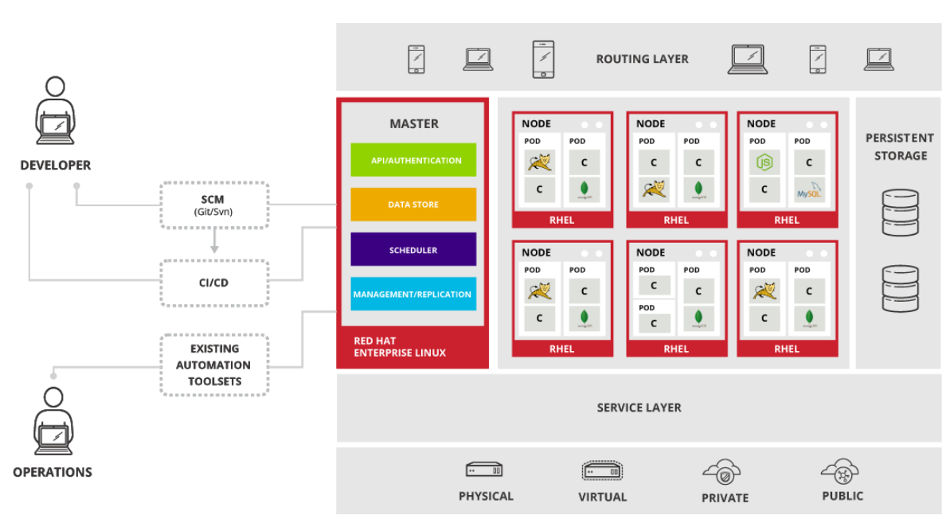
Control Plane Deep Dive
Notes:
1.7.2013
null
‹#›

Slide 12



Control Plane Deep Dive
API Server
etcd Database
Scheduler
Controller Manager
Central management component that exposes the Kubernetes API. Handles authentication, authorization, and validates API requests from users and internal components.
Distributed key-value store that maintains cluster state and configuration data. Provides high availability and consistency for critical cluster information.
Determines optimal node placement for pods based on resource requirements, constraints, and cluster policies. Ensures efficient resource utilization.
Enforces the desired state. If you ask for 5 pods, but only 4 are running, it ensures a new one is created.
Notes:
1.7.2013
null
‹#›

Slide 13


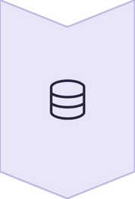
The Control System
Scheduler
Traffic controller that decides which node should run each pod based on available resources.
Controller Manager
Quality inspector that ensures the cluster matches desired state and restarts failed pods.
etcd
The cluster's memory that stores all configurations and maintains current state information.
When you deploy a pod: API server receives request → Controller verifies state → Scheduler assigns node → Pod starts running
Notes:
1.7.2013
null
‹#›

Slide 14


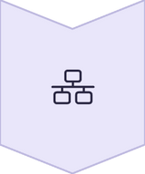
Worker Node Components
kubelet
Node agent that communicates with control plane and manages pod lifecycle on the node
Container Runtime
CRI-O runtime that pulls images and runs containers within pods
kube-proxy
Network proxy that handles service discovery and load balancing for pods
Notes:
1.7.2013
null
‹#›

Slide 15



OpenShift Architecture Deep Dive
1
OpenShift Layer
Enterprise features: OAuth server, Routes, Templates, Web Console
2
Kubernetes Layer
Core orchestration: API Server, Scheduler, Controller Manager, etcd
3
Node Components
RHCOS, Kubelet, CRI-O runtime, Ignition bootstrapping
OpenShift adds enterprise usability and security on top of Kubernetes, creating a complete platform for production workloads.
Notes:
1.7.2013
null
‹#›

Slide 16

OpenShift-Specific Services
Image Registry
Router/Ingress
Web Console
Internal container registry for storing and managing application images with integrated security scanning and access controls.
HAProxy-based routing layer that provides external access to services with SSL termination and traffic management.
Comprehensive web-based management interface for developers and administrators to manage applications and cluster resources.
Notes:
1.7.2013
null
‹#›

Slide 17
Software-Defined Networking
Internal Communication
External Exposure
Pod-to-pod networking across nodes
Routes for external URL mapping
Service discovery with stable DNS names
Integrated TLS termination
Load balancer integration
Virtual IP addresses for service abstraction
Enterprise firewall compatibility
Multi-tenant network isolation policies
OpenShift's networking goes beyond Kubernetes Ingress with native Routes that automatically handle external exposure, TLS certificates, and enterprise network integration without complex configuration.
Notes:
1.7.2013
null
‹#›

Slide 18




Enterprise Security Framework
Security Context Constraints
RBAC & Identity
Image Security
Fine-grained role-based access control with OAuth2 integration for enterprise identity providers like LDAP and Active Directory.
Built-in vulnerability scanning, signed image verification, and ImageStreams for secure container lifecycle management.
Strict defaults prevent containers from running as root unless explicitly authorized, reducing privilege escalation risks.
Unlike Kubernetes where security must be configured manually, OpenShift enforces enterprise security standards from day one, making it ideal for compliance-heavy industries like healthcare and finance.
Notes:
1.7.2013
null
‹#›

Slide 19
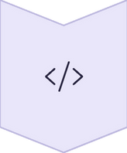



Developer Experience Revolution
Source-to-Image
Push code directly from Git repositories without writing Dockerfiles
BuildConfigs
Automated container builds with triggers for security updates
Web Console
Visual deployment and monitoring without YAML complexity
Operators
Application lifecycle automation for complex services
OpenShift removes the steep Kubernetes learning curve, enabling developers to focus on application logic rather than infrastructure complexity.
Notes:
1.7.2013
null
‹#›

Slide 20
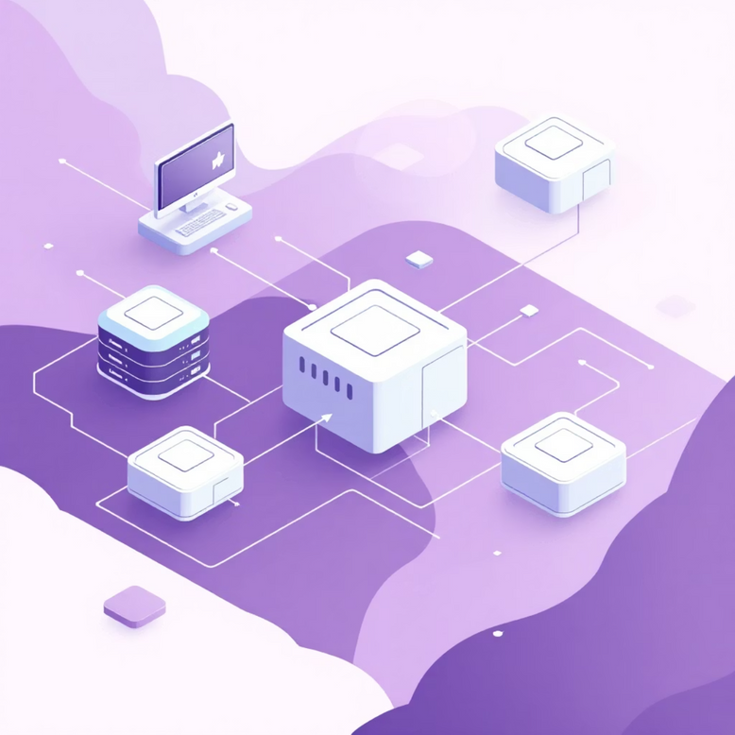
Persistent Storage Strategy
Storage Abstraction
Persistent Volumes and Claims decouple applications from storage infrastructure, supporting NFS, Ceph, cloud storage, and enterprise arrays.
Dynamic Provisioning
StorageClasses enable self-service storage allocation with automatic provisioning from configured storage pools.
Stateful Applications
StatefulSets with persistent storage identity ensure data consistency for databases and message queues across pod restarts.
This enterprise-grade storage support makes OpenShift suitable for both stateless microservices and data-intensive applications requiring persistent state.
Notes:
1.7.2013
null
‹#›

Slide 21





High Availability & Self-Healing
Failover Protection
Automatic Scaling
3 master nodes ensure continuous operation even if one fails. No single point of failure in your infrastructure.
Pods scale manually or automatically based on CPU and memory usage, handling traffic spikes seamlessly.
Self-Healing
Failed pods are automatically rescheduled to healthy nodes, maintaining uninterrupted service for critical applications.
Example: 100 pods on 10 nodes—if a node fails, pods automatically move to healthy nodes with zero downtime.
Notes:
1.7.2013
null
‹#›

Slide 22
Enterprise Success Stories
Financial Services
Retail & E-commerce
Healthcare
Banks leverage OpenShift's security controls and audit capabilities to meet PCI-DSS compliance while enabling rapid application development.
Major retailers handle traffic spikes during peak shopping events using OpenShift's autoscaling and persistent storage capabilities.
Healthcare organizations achieve HIPAA compliance through integrated identity management and centralized logging while modernizing patient care systems.
These organizations chose OpenShift because the operational savings, compliance benefits, and developer productivity gains outweigh licensing costs compared to assembling equivalent capabilities with vanilla Kubernetes.
Notes:
1.7.2013
null
‹#›

Slide 23
Key Architectural Benefits
99.9%
10x
50%
High Availability
Faster Deployment
Resource Efficiency
Enterprise-grade uptime with automated failover and recovery
Streamlined CI/CD pipelines and developer workflows
Better utilization through intelligent scheduling and autoscaling
OpenShift's architecture delivers enterprise resilience, developer productivity, and operational efficiency at scale.
Notes:
1.7.2013
null
‹#›

